Slide 1


© 2013, Université catholique de Louvain
PROTECTION AND TRANSFER OF THE INTELLECTUAL PROPERTY AT UCL
Sébastien ADAM - sebastien.adam@uclouvain.be
Louvain Technology Transfer Office - Administration de la Recherche

Slide 2
PROTECTION AND TRANSFER OF THE INTELLECTUAL PROPERTY AT UCL
© 2013, Université catholique de Louvain
LTTO
Protecting intellectual property rights
Tools and best practices
Sébastien ADAM - sebastien.adam@uclouvain.be
Louvain Technology Transfer Office - Administration de la Recherche

Slide 3
PROTECTION AND TRANSFER OF THE INTELLECTUAL PROPERTY AT UCL
© 2013, Université catholique de Louvain
LTTO
Sébastien ADAM - sebastien.adam@uclouvain.be
Louvain Technology Transfer Office - Administration de la Recherche

Slide 4
UCL also intends to act in the service of the community
Good research is a source of progress
Your research is thus useful for the society
Research to Innovation
Knowledge transfer
Job creation
Regional development
…
UCL wishes to protect and promote the findings of research carried out in its laboratories and units.
The Louvain Technology Transfer Office (LTTO) was set up to enhance technology transfer and the promotion of knowledge within society.

Slide 5

Knowledge and Technology Transfer office
Companies
Others
Universities
EASYNOVE
PICARRE
…
Society
KTOs
Funds providers
Researchers
Master’s thesis students

Slide 6
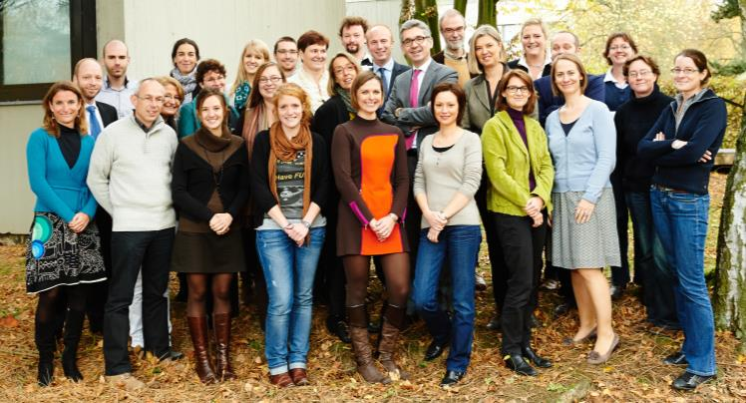
LTTO: the Knowledge and Technology Transfer office of UCL
A pluridisciplinary team (scientifics, lawyers, economists,…)
to connect UCL’s researchers and external partners:
Promotion of knowledge and technology transfer
Single contact point for the research community
Continuity in the technology transfer process
Business developer
Patent manager
Legal advisor (SOPARTEC)
Legal advisor (ADRE)
Funding advisor
Technological advisor
(Valorisateur)

Slide 7
LTTO: the Knowledge and Technology Transfer office of UCL
A pluridisciplinary team (scientifics, lawyers, economists,…)
to connect UCL’s researchers and external partners:
Promotion of knowledge and technology transfer
Single contact point for the research community
Continuity in the technology transfer process
Business developer
Patent manager
Legal advisor (SOPARTEC)
Legal advisor (ADRE)
Technological advisor ;-)
ICT / Micro & Nanotechnologies
Funding advisor
Technological advisor
(Valorisateur)

Slide 8




Technology transfer process @UCL

Slide 9
Technology transfer process @UCL
Intellectual property (IP): Legal concept which refers to creations of the mind for which exclusive rights are recognized.
IP@UCL: research findings obtained in the context of research carried out at UCL
by individuals connected with the University,
in their research fields,
made with the use of UCL equipment or staff.

Slide 10
PROTECTION AND TRANSFER OF THE INTELLECTUAL PROPERTY AT UCL
© 2013, Université catholique de Louvain
LTTO
Protecting the intellectual property rights
Sébastien ADAM - sebastien.adam@uclouvain.be
Louvain Technology Transfer Office - Administration de la Recherche

Slide 11
Software & algorithm require specific attentions
Method, Algorithm, Functionality, Software...
Program,
Preparatory design Material,
Architecture,
Name/logo, Documentation…
Collective,
Collaborative,
Composite…

Slide 12
Protecting your intellectual property rights

Slide 13
Confidentiality
The information you will have access in the framework of your master thesis are confidential by default
Non-Disclosure Agreement [NDA]
Confidential Disclosure Agreement [CDA]
Allows the university to disclose secret information to an external partner
Especially relevant when a company is involved
Meetings preparing a possible scientific or commercial collaboration, PhD/master thesis defense, final project presentation, internship,…
Must be signed by rector on behalf of the university
www.uclouvain.be/en-373682

Slide 14
Confidentiality is often required by the research partner
Confidential information by default
Permission required to disclose
…
A consortium agreement is signed (read it!) and the university agrees to respect it
Academics, researchers, technicians, students,… must respect it too

Slide 15
Protecting your intellectual property rights

Slide 16
Copyright regulations
Copyright protects the form: the source code and the executable software
As soon as the work is created
No formalities
Long-term & inexpensive protection
A single condition: originality
An official deposit of the source code…
good practice to provide proof of authorship and priority (easy to prove for identical copies)
only a limited protection
(complicated to show infringement in case of “inspiration”)

Slide 17
Copyright regulations
The author is the rights holder, with an exception when the software is created «in the execution of duties or following the instructions of the employer»
Moral rights belong to the author
They are perpetual, inalienable and imprescriptible. The author can not sell/lost them through non-use.
Disclosure: decision for the first availability,
Repentance and withdrawal,
Paternity: respect for his name and quality,
Integrity: respect for his work.
See the regulations on copyright that apply at UCL - www.uclouvain.be/407

Slide 18
Copyright regulations
The author is the rights holder, with an exception when the software is created «in the execution of duties or following the instructions of the employer»
Economic rights of researchers are transferred to the university (= exclusive right of exploitation)
The university transfers the rights of use or exploit a software, usually non-exclusively.
Reproduction: including loading, displaying, running, transmission or storage,
Distribution: authorize the placing on the market, for payment or free of charge,
Modification: translation, adaptation, modification.
See the regulations on copyright that apply at UCL - www.uclouvain.be/407

Slide 19
Protecting your intellectual property rights

Slide 20
Transfer of the economic rights through licensing
The university (researchers, master thesis students, LTTO) have to think together about the license under which the software will be distributed
UCL may not transfer more rights than it has:
Source code developed in the exercise of the researchers duties ?
Insertion of source code belonging to a third party ?
In case of use to others, is the transfer of rights formalized through licensing ?

Slide 21
Transfer of the economic rights through licensing
The university (researchers, master thesis students, LTTO) have to think together about the license under which the software will be distributed
UCL may not transfer more rights than it has:
Source code developed in the exercise of the researchers duties ?
Insertion of source code belonging to a third party ?
In case of use to others, is the transfer of rights formalized through licensing ?
The license used for the distribution (selling software, installing it on a computer or offering it as a download from a website) should be defined as early as possible.

Slide 22
Transfer of the economic rights through licensing
The university (researchers, master thesis students, LTTO) have to think together about the license under which the software will be distributed
UCL may not transfer more rights than it has:
Source code developed in the exercise of the researchers duties ?
Insertion of source code belonging to a third party ?
In case of use to others, is the transfer of rights formalized through licensing ?
The license used for the distribution (selling software, installing it on a computer or offering it as a download from a website) should be defined as early as possible.
All types of license are contracts (!). The relative freedom depends on the rights recognized through the license.

Slide 23
Transfer of the economic rights through licensing
The university (researchers, master thesis students, LTTO) have to think together about the license under which the software will be distributed
UCL may not transfer more rights than it has:
Source code developed in the exercise of the researchers duties ?
Insertion of source code belonging to a third party ?
In case of use to others, is the transfer of rights formalized through licensing ?
The license used for the distribution (selling software, installing it on a computer or offering it as a download from a website) should be defined as early as possible.
All types of license are contracts (!). The relative freedom depends on the rights recognized through the license.
Unified ownership of the entire source code: a co-owner could potentially block future developments, whether in a scientific collaboration or for commercial purposes.

Slide 24
Open-Source/proprietary software are based on the copyright law
Proprietary license: Source code not distributed
Under control (source code is secret).
Sometimes imposed (partner or patent in progress).
Open-source license: Source code accessible
Use, study, modification, duplication and distribution are universally permitted without compensation.
Provided with all relevant information.
Sometimes imposed (existing open-source project or partner’s requirements).

Slide 25
Open-source license: Permissive vs. Copyleft
Open-source does not mean « without constraints » and sometimes have a strong reciprocity obligation.
Permissive
Only the obligations of the receiver have to be transmitted.
Close to the public domain, as they generally impose only the respect of paternity.
Copyleft
The adaptation is itself free of rights. The granted freedoms are persistent as the subsequent users automatically grant the same freedoms.
The interest of the end user overrides the freedom of those who diffuse the work.
Notes:
ACADEMIC LICENSES: BSD, MIT
Unconditional sharing of knowledge.
A short and clear description
COMMUNITY LICENSES: Artistic, Apache
Mainly from OS projects, which use their own license.
Little legal interpretations and frequent hazardous interpretations.
Essentially permissive, but their specificity makes them difficult to reconcile with most copyleft licenses.

Slide 26
Open-source license: Examples
PERMISSIVE
COPYLEFT
Notes:
ACADEMIC LICENSES: BSD, MIT
Unconditional sharing of knowledge.
A short and clear description
COMMUNITY LICENSES: Artistic, Apache
Mainly from OS projects, which use their own license.
Little legal interpretations and frequent hazardous interpretations.
Essentially permissive, but their specificity makes them difficult to reconcile with most copyleft licenses.
GNU LICENSES: General Public License (GPL), Library GPL (now Lesser GPL), Affero GPL, Simpler FDL…
Require that all derivative software is itself subject to the same license.
Companies are often reluctant to resort to these licenses whose implications are sometimes uncertain.
INSTITUTIONAL LICENSES: MPL
Introduced by companies interested in the cooperative development of their product.
Weak copyleft: source code only

Slide 27
Issues of the compatibility clause
It may be impossible to choose a license (and thus to distribute or use a software) if the final product integrates incompatible components.
Concerns the software distribution.
Not all open-source licenses are mutually compatible.
A license is compatible if it replaces another in accordance with all its terms.
Either the license requires a distribution on its own terms or on those of a set of determined licenses (express compatibility), or a logical analysis of the context is required to ensure that we do not require to the end user less than we are ourselves obliged (induced compatibility).

Slide 28




Issues of the compatibility clause
Reciprocity: BSD is MIT-compatible and MIT is BSD-compatible
☺
☺
False idea of reciprocity: BSD is GPL-compatible but GPL is not BSD-compatible
☺
☹
Complete incompatibility: Mozilla is not GPL-compatible and GPL is not Mozilla-compatible
☹
☹

Slide 29
Protecting your intellectual property rights

Slide 30
Trademark regulations
Trademarks - name, symbol or logo - can be useful for differentiating products or services from the competition
Trademarks…
prevent a similar / identical name from being used
useful for protecting a reputation/brand image
relatively inexpensive
last for as long as you pay to maintain them and they remain in use
efficiently protect renowned software
Trademarks do not…
prevent the imitation or the development of a similar software by a competitor

Slide 31
Protecting your intellectual property rights

Slide 32
Patent regulations
Unlike copyright, patents protect functionality, regardless of how it is written
A technical solution to a technical problem
Criteria: novelty, inventiveness and industrial application
Right to prohibit others from exploiting the invention in a given territory
Limited in time (20 years) - upon payment of annual fees
Patent ≠ scientific paper ⇒ Inventor ≠ author
More specifically
Software as such is excluded from the scope of patentable inventions
The software functions can be protected provided that they are used in the creation of a technical effect
Patents are made public 18 months after the application and describe the content in detail: this gives your competitors everything they need to draw inspiration from the code!

Slide 33
Protecting your intellectual property rights

Slide 34
Databases regulations
Contents
Sui generis law protects the investments required to obtain a validated, high-quality database
Protection for the persons who take the initiative and assume the risk of making the investments required to compile the database.
Protection of the contents (15 years):
the right to oppose the extraction of all or a substantial part,
the right to oppose the reuse of all or a substantial part.
Structure
The original structure of the arranged elements is protected by copyright
No formality is required.
Important to be able to offer proof of priority and thus to establish a certain creation date.

Slide 35
Protecting your intellectual property rights

Slide 36
PROTECTION AND TRANSFER OF THE INTELLECTUAL PROPERTY AT UCL
© 2013, Université catholique de Louvain
LTTO
Protecting the intellectual property rights
Tools and best practices
Sébastien ADAM - sebastien.adam@uclouvain.be
Louvain Technology Transfer Office - Administration de la Recherche

Slide 37
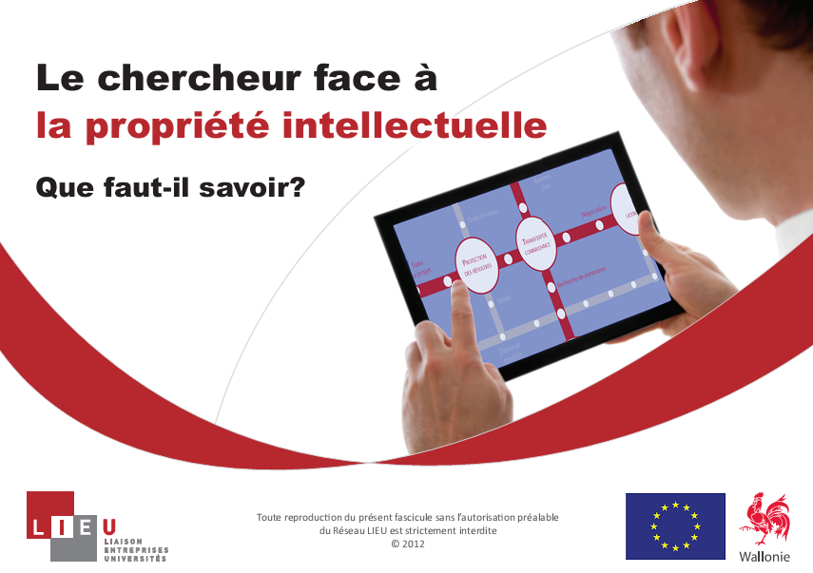


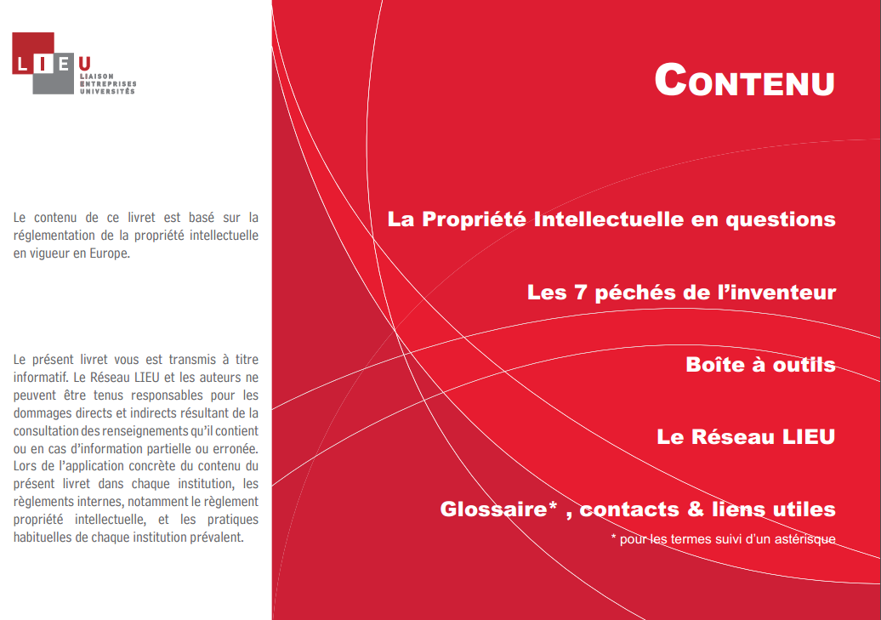



IP brochure of the LIEU network

Slide 38
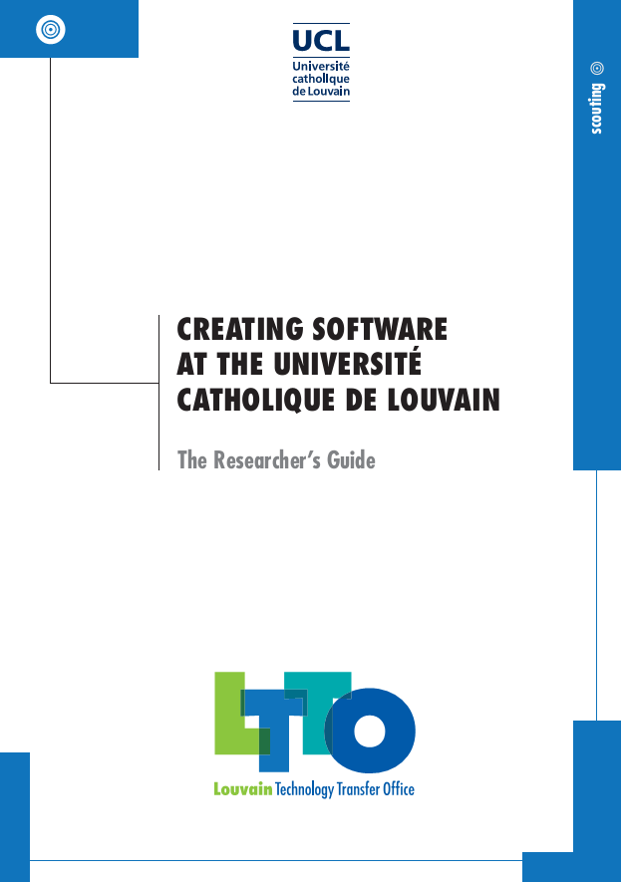

Software guide of the LIEU network
An overview for everyone in the University who is involved in the development of software or algorithms:
Using software
Distributing your software:
Commercial or Open-source license
Integrating Open-Source code
How to protects your rights?
Best practices for developing code
Recommended readings

Slide 39
Confidentiality agreement and transfer of rights (master thesis)
(…) In the context of this master thesis, UCL agrees to make available scientific, technical, commercial or financial information (…) as well as samples, plans, drawings, models, software, prototypes etc.. related to the project, and gives access to many resources (units, infrastructure, equipment…)

Slide 40
Confidentiality agreement and transfer of rights (master thesis)
(…) In the context of this master thesis, UCL agrees to make available scientific, technical, commercial or financial information (…) as well as samples, plans, drawings, models, software, prototypes etc.. related to the project, and gives access to many resources (units, infrastructure, equipment…)
I acknowledge that (…) shall be deemed confidential all information which I have access, directly or indirectly in the performance of tasks that will be entrusted to me (…)
In any case, during the execution of my master thesis and after his term (…) I do not disclose the contents to any third party (…) and will not use them for my own account or on behalf of a third party.

Slide 41
Confidentiality agreement and transfer of rights (master thesis)
(…) In the context of this master thesis, UCL agrees to make available scientific, technical, commercial or financial information (…) as well as samples, plans, drawings, models, software, prototypes etc.. related to the project, and gives access to many resources (units, infrastructure, equipment…)
I acknowledge that (…) shall be deemed confidential all information which I have access, directly or indirectly in the performance of tasks that will be entrusted to me (…)
In any case, during the execution of my master thesis and after his term (…) I do not disclose the contents to any third party (…) and will not use them for my own account or on behalf of a third party.
I have read the regulations governing ownership, protection and promotion of the findings of research carried out at UCL, recognizing the ownership of research results, and I adhere to them.
UCL thus acquires ownership of the results that I will develop within the framework of my master thesis.

Slide 42
© 2013, Université catholique de Louvain
PROTECTION AND TRANSFER OF THE INTELLECTUAL PROPERTY AT UCL
- Thanks for your attention -
Sébastien ADAM - sebastien.adam@uclouvain.be
Louvain Technology Transfer Office - Administration de la Recherche

